Slide 1

Automata Theory (ITC404)
VES INSTITUTE OF TECHNOLOGY
DEPARTMENT OF INFORMATION TECHNOLOGY
BY
Mrs Charusheela Nehete
Assistant Professor,
IT Department ,
VESIT

Slide 2
Module 2 -Finite Automata
Finite Automata: FA as language acceptor or verifier, NFA ( with and without ε) , DFA, RE to NFA, NFA to DFA, Reduced DFA , NFA-DFA equivalence, FA to RE. Finite State Machines with output : Moore and Mealy machines. Moore and Mealy M/C conversion. Limitations of FA.
Self-learning Topics: Practice exercise on FA and NFA

Slide 3
Contents
Basic Machine
Finite State Machine
Finite Automaton (FA)
Deterministic Finite Automata (DFA)
Formal Definition
Transition Diagram
Examples

Slide 4
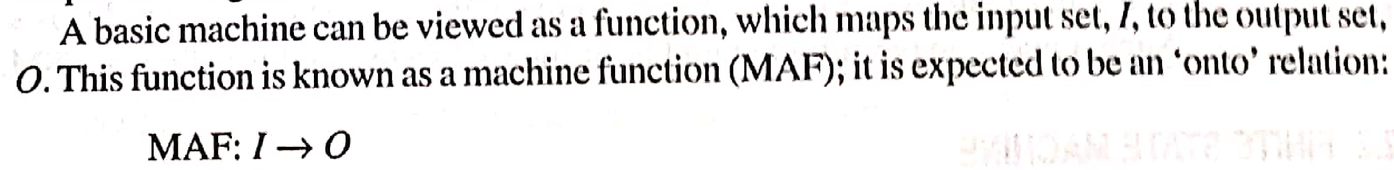
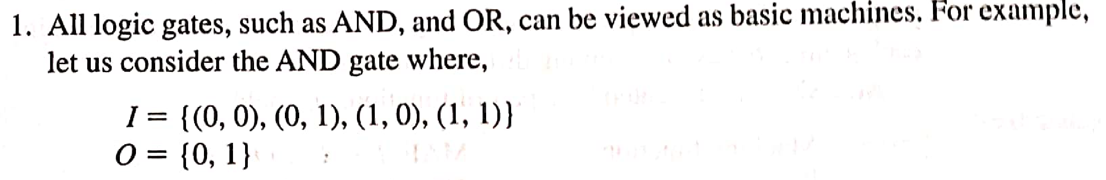
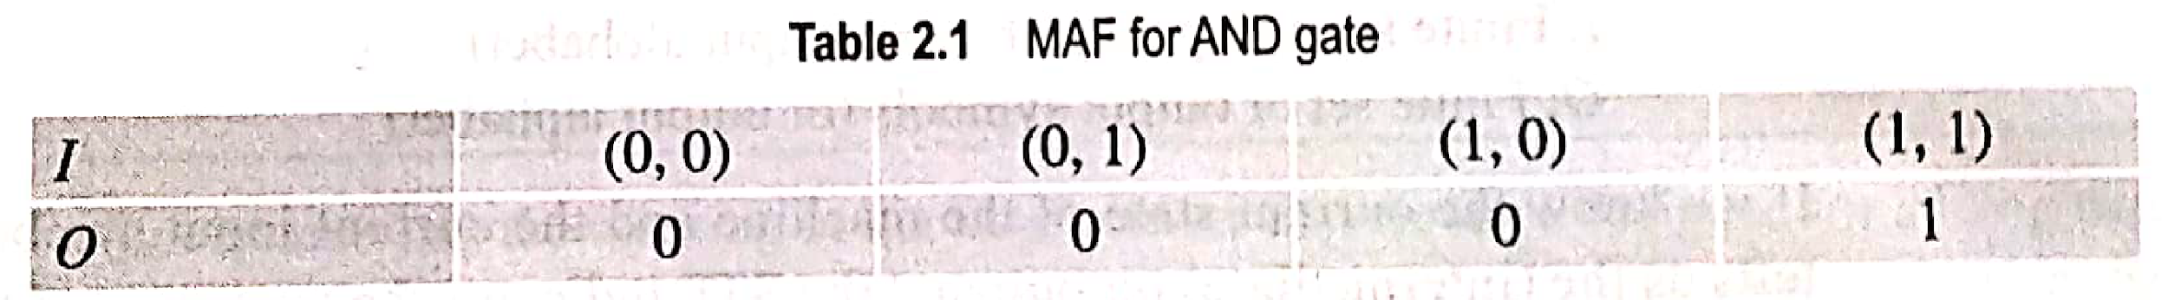
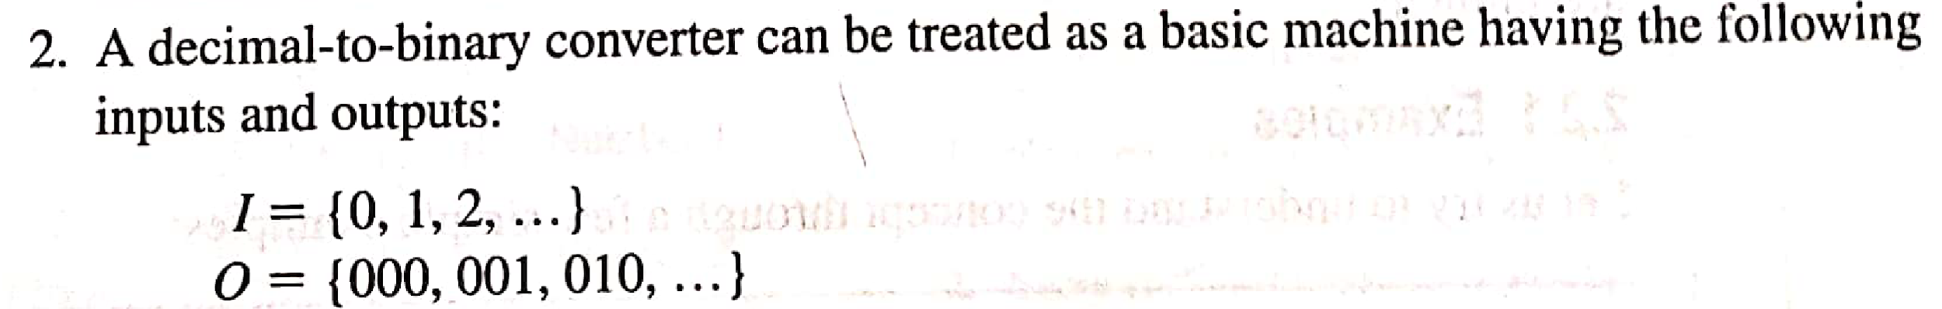
Basic Machine

Slide 5
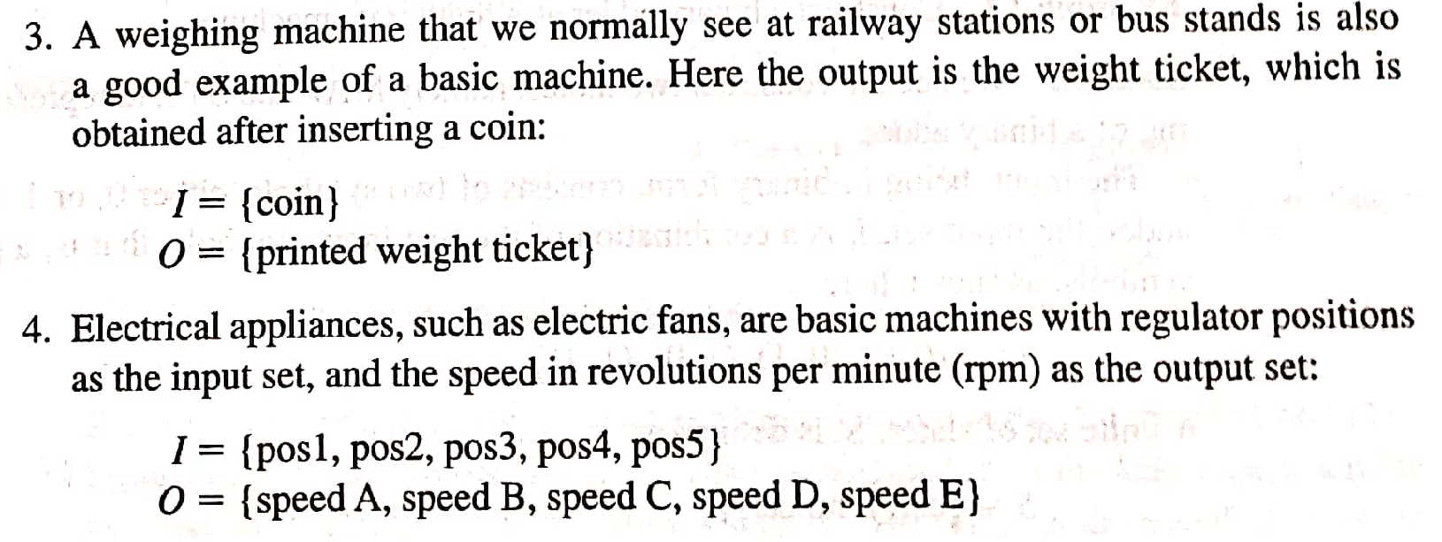
Basic Machine Examples(Cntd..)

Slide 6
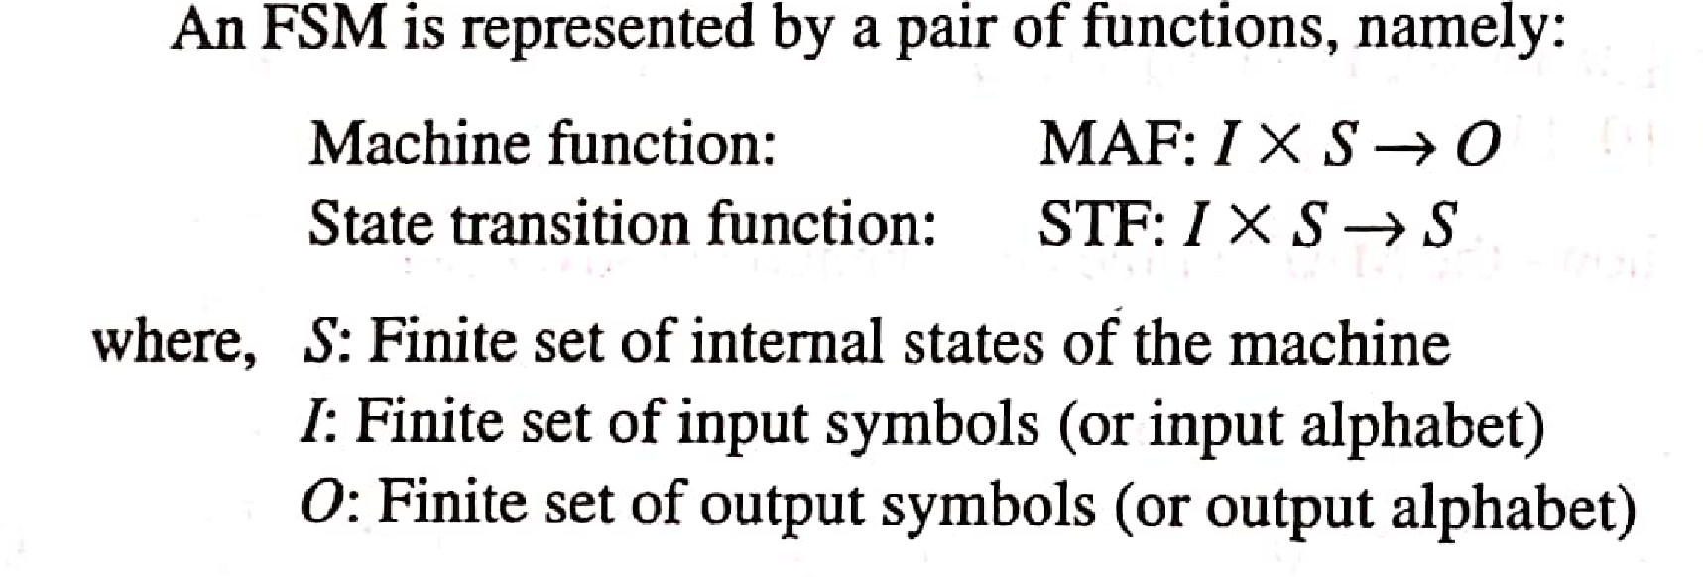
Finite State Machines FSM)
Unlike basic machine, in FSM, we are concerned with machine behavior, regarding in which internal state machine is and how machine behaves upon receiving different intermediate inputs in the current state.

Slide 7
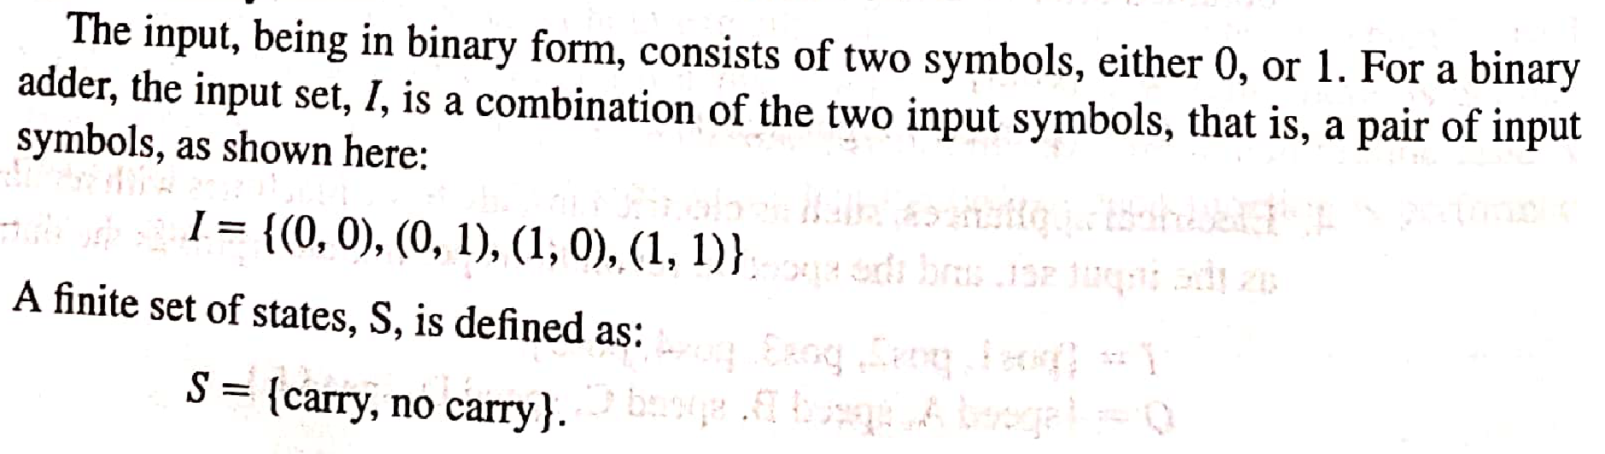
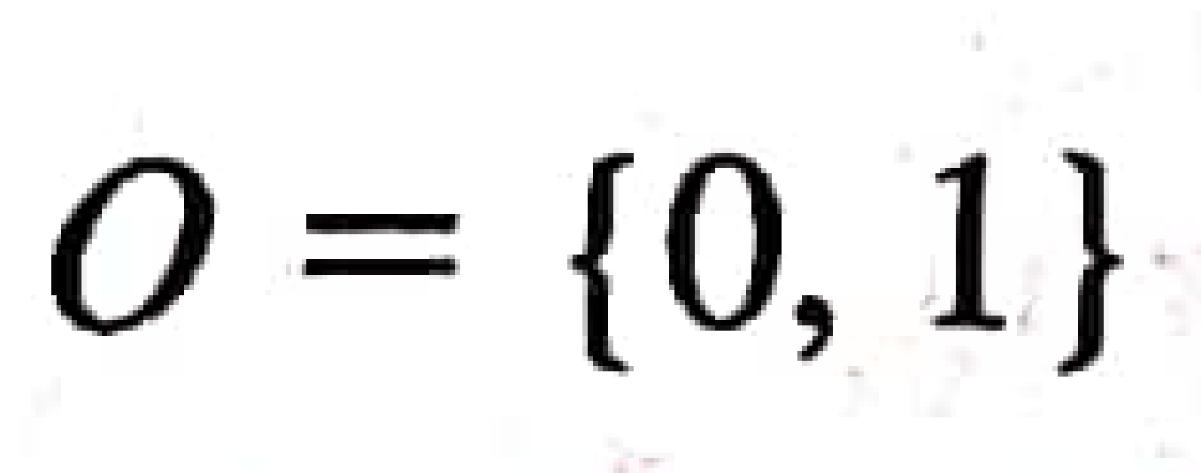
FSM: Examples
Example 1: Construct a FSM for Binary adder

Slide 8
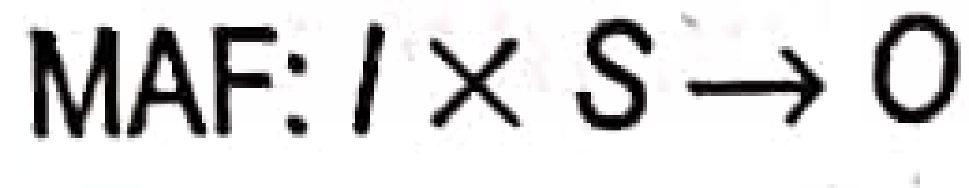
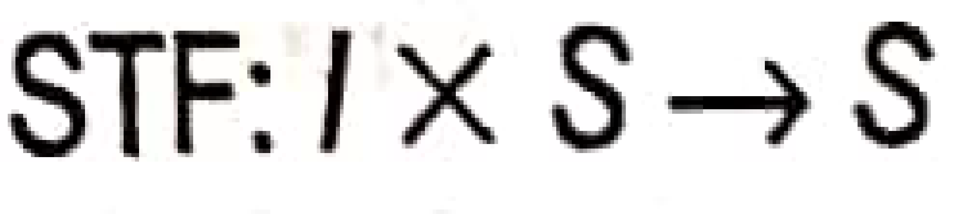
FSM: Examples
Construct a FSM for Binary adder
I S | Carry | No Carry
(0,0)
(0,1)
(1,0)
(1,1)
I S | Carry | No Carry
(0,0)
(0,1)
(1,0)
(1,1)
1
1
No Carry
0
0
No Carry
Carry
0
No Carry
0
1
1
0
0
Carry
1
1
No Carry
1
1
0
Carry
0
Carry

Slide 9
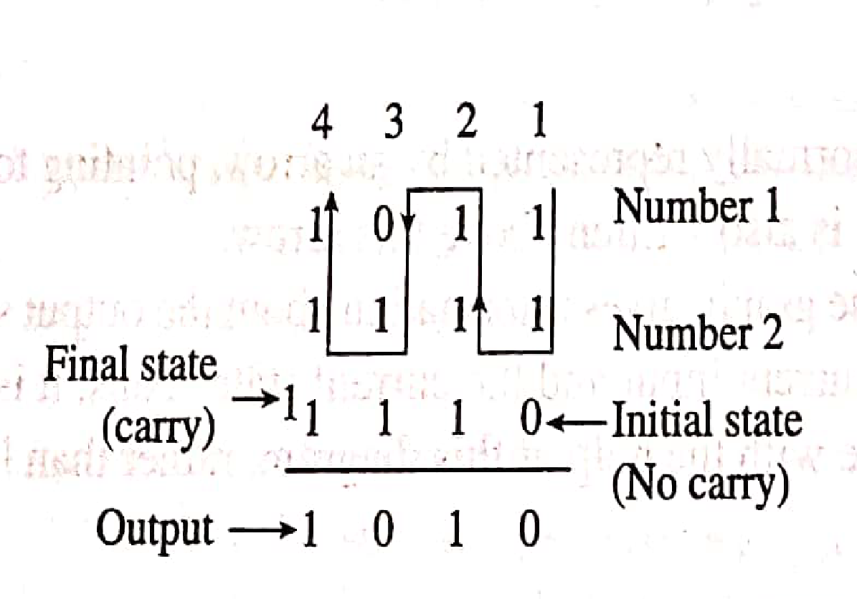

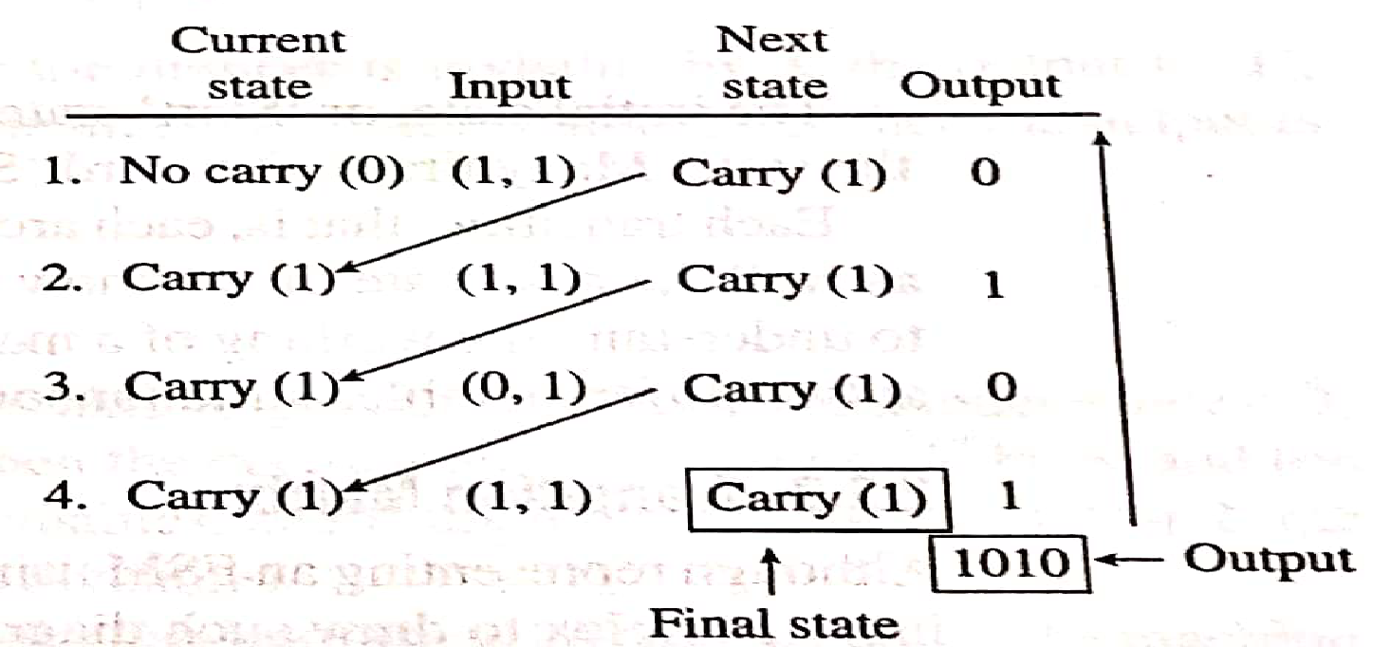
I S | Carry | No Carry
(0,0)
(0,1)
(1,0)
(1,1)
I S | Carry | No Carry
(0,0)
(0,1)
(1,0)
(1,1)
1
1
No Carry
0
0
No Carry
Carry
0
No Carry
0
1
1
0
0
Carry
1
1
No Carry
1
1
0
Carry
0
Carry

Slide 10
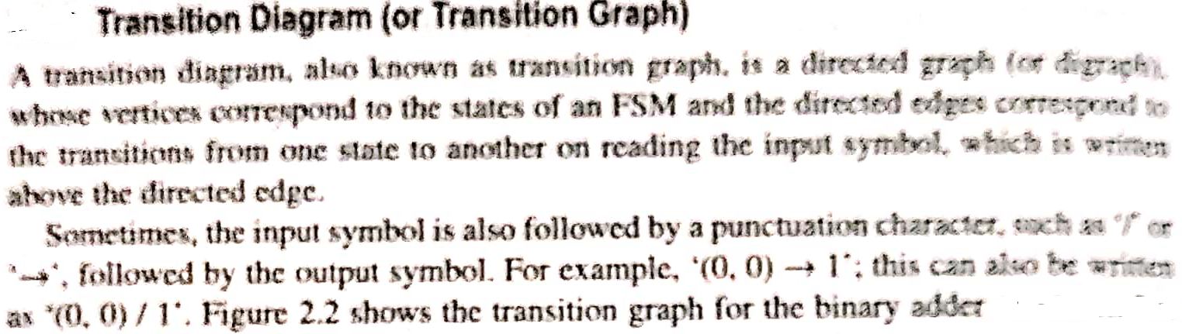
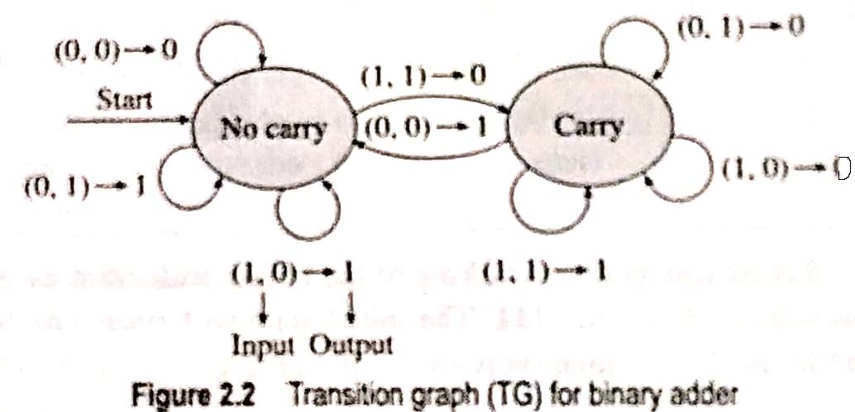

Slide 11
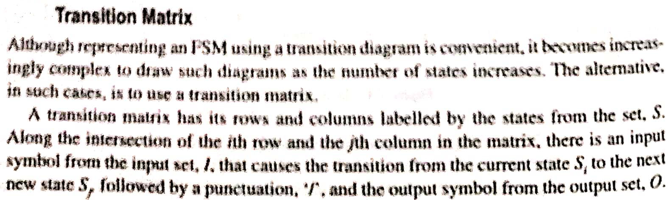
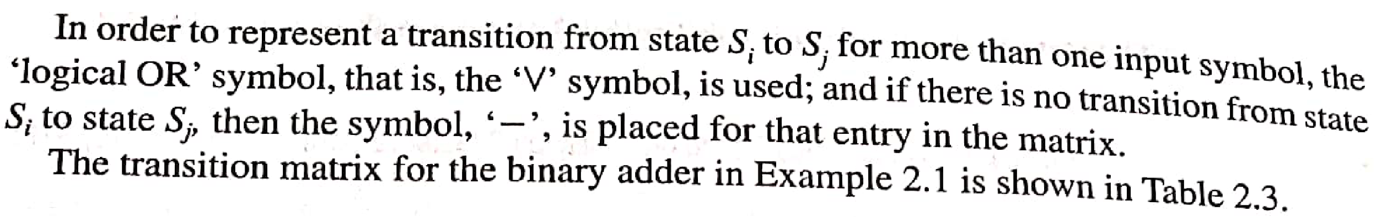
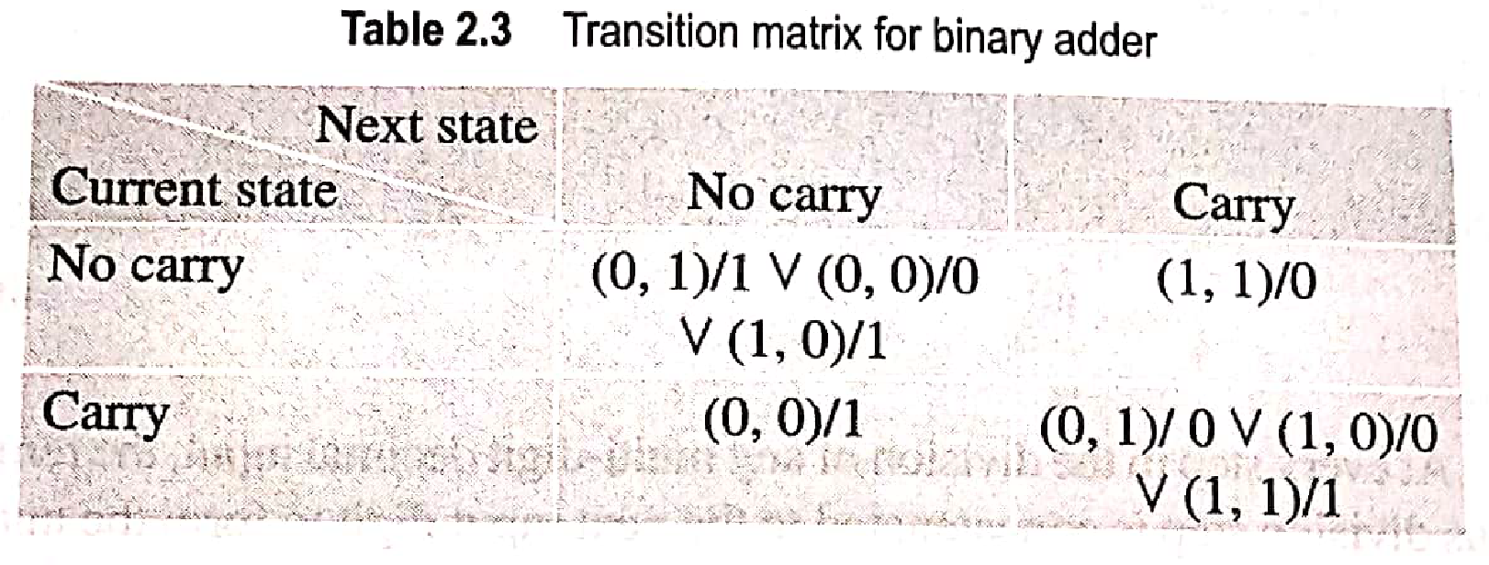

Slide 12
Design/Construct a FSM Steps:
Set of Input Symbols (I)
Set of States (S)
MAF,STF
TG / TM
Simulation

Slide 13
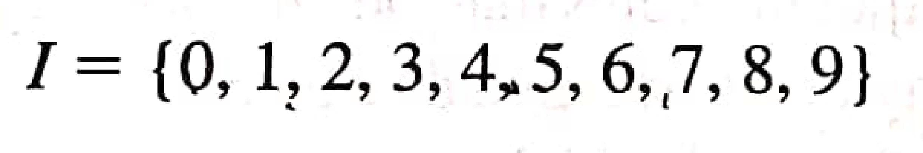
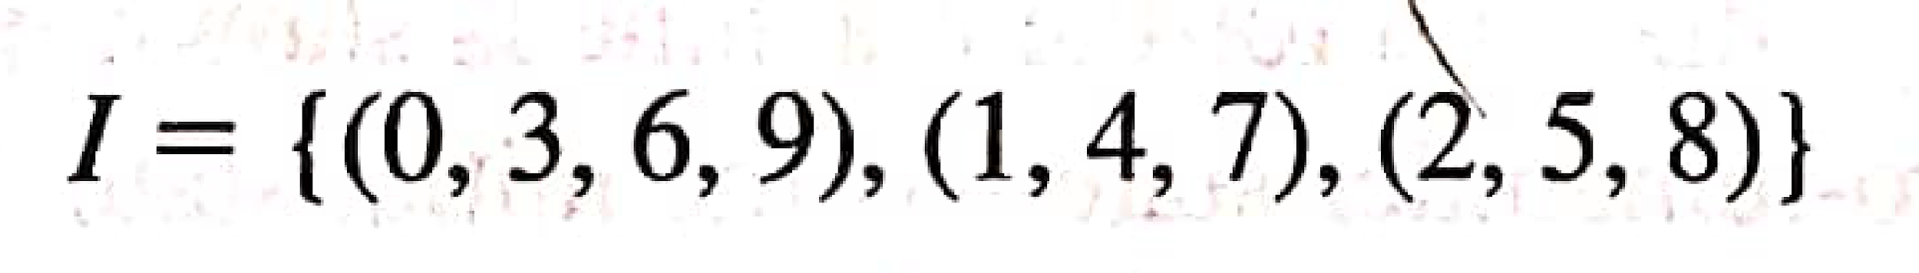
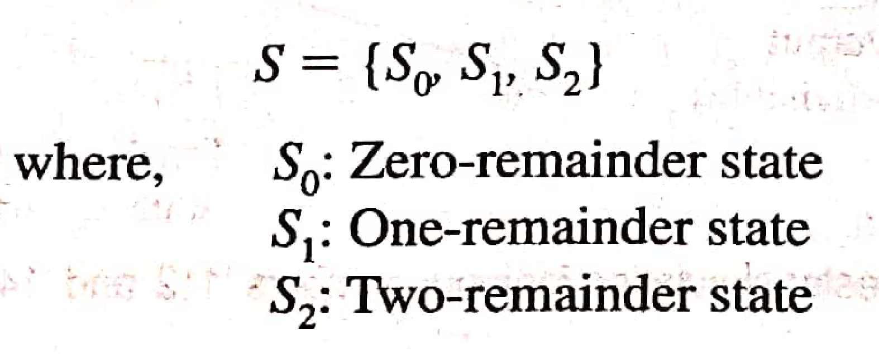
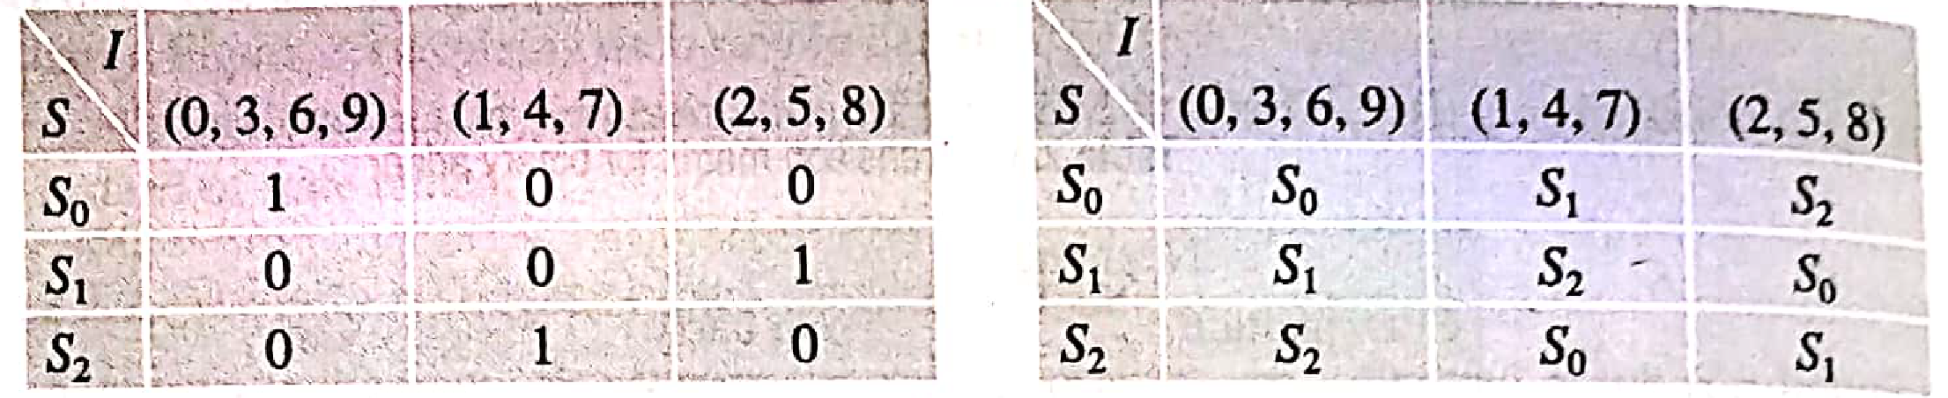
Example 2:

Slide 14
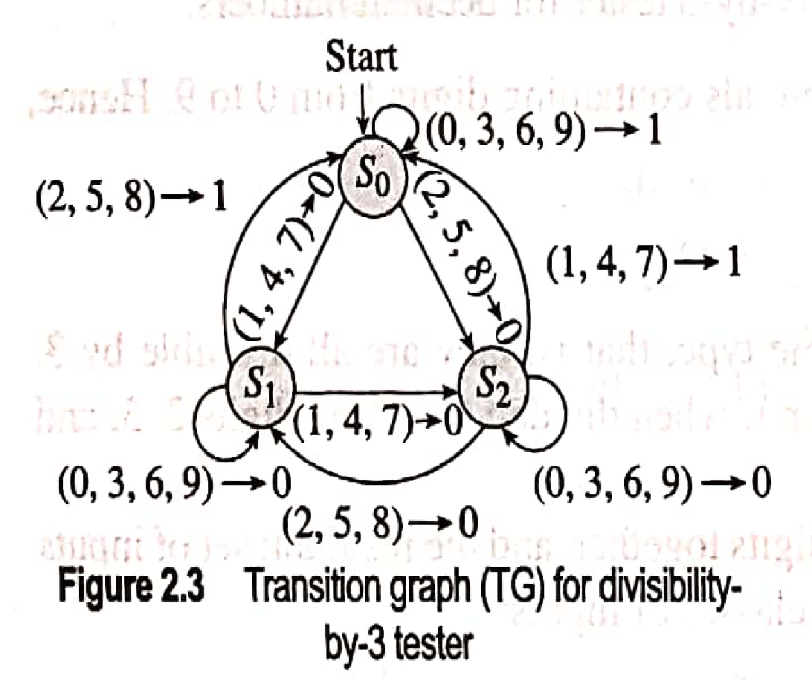
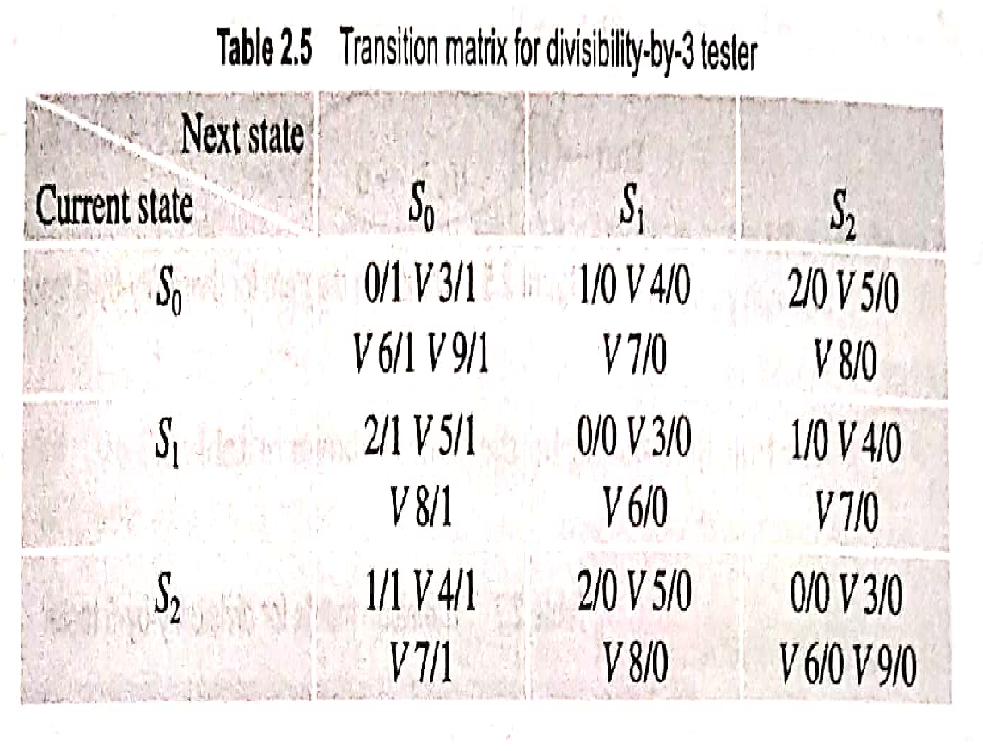

Slide 15
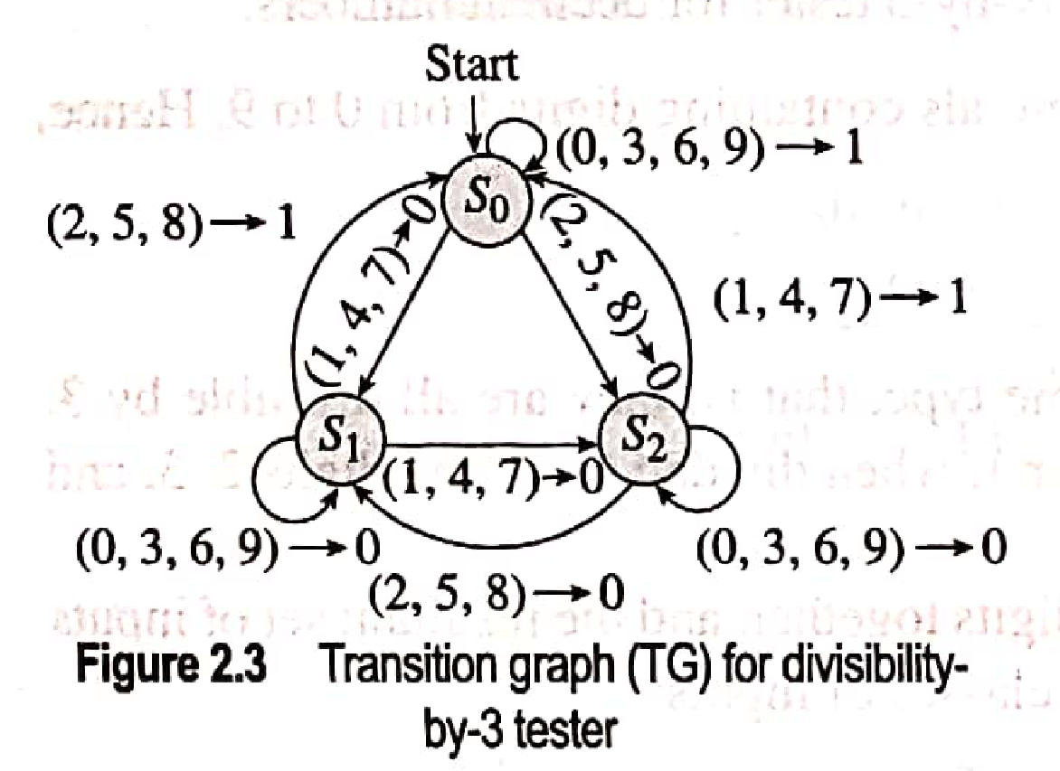
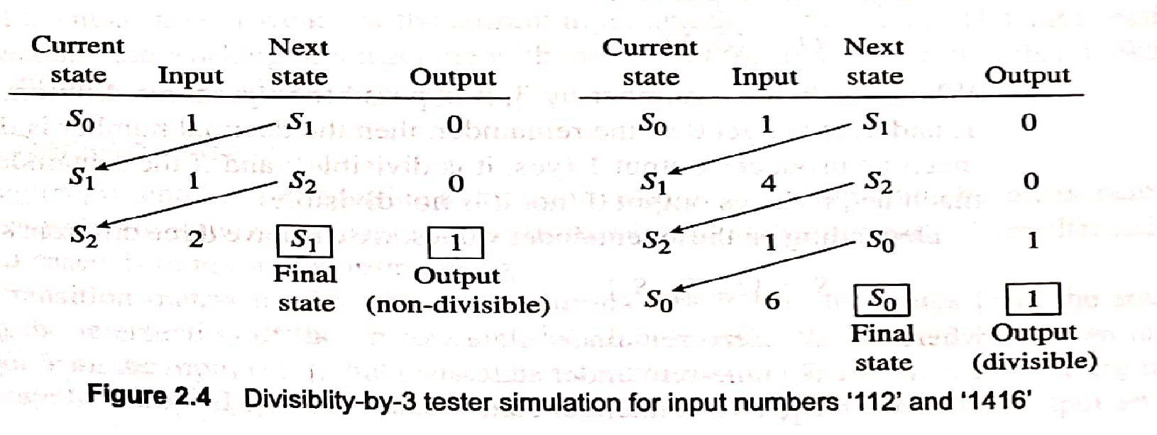

Slide 16
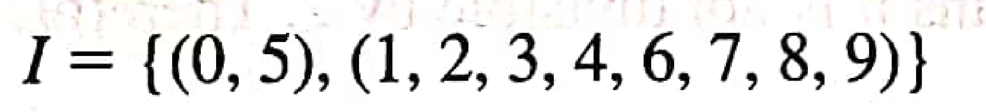
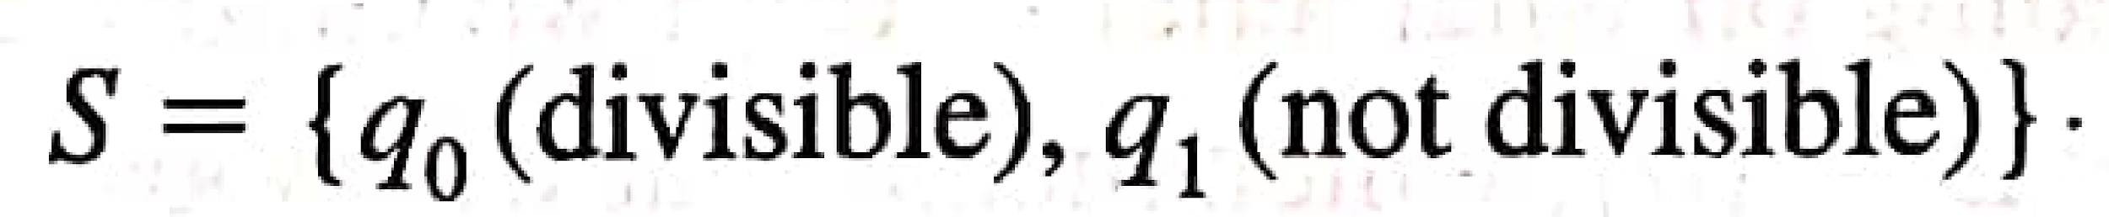
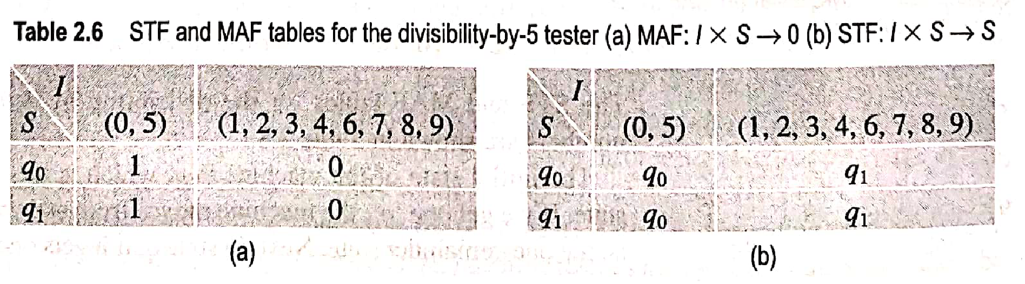
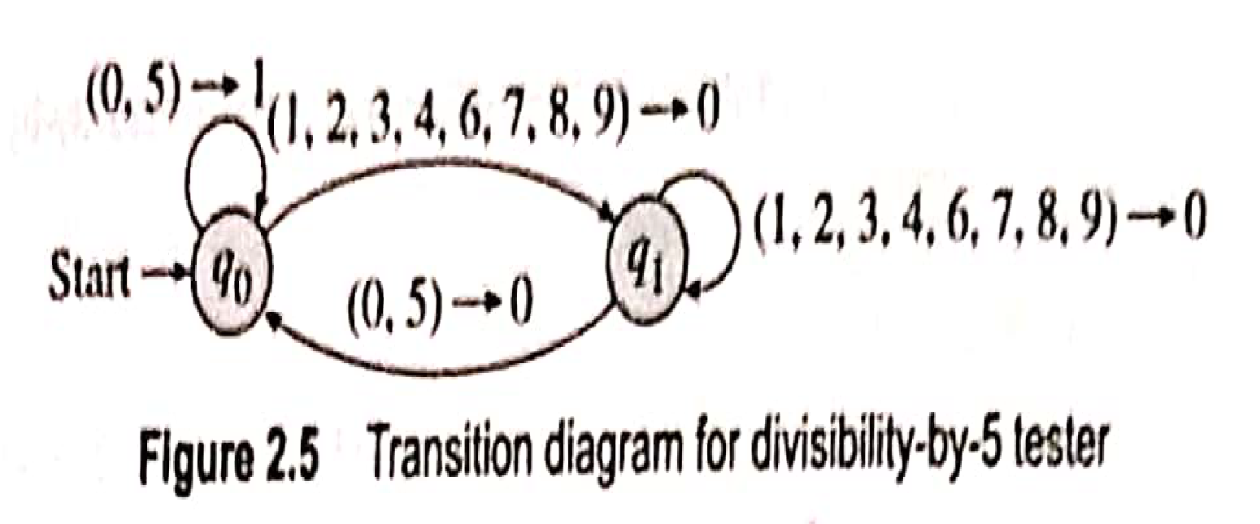
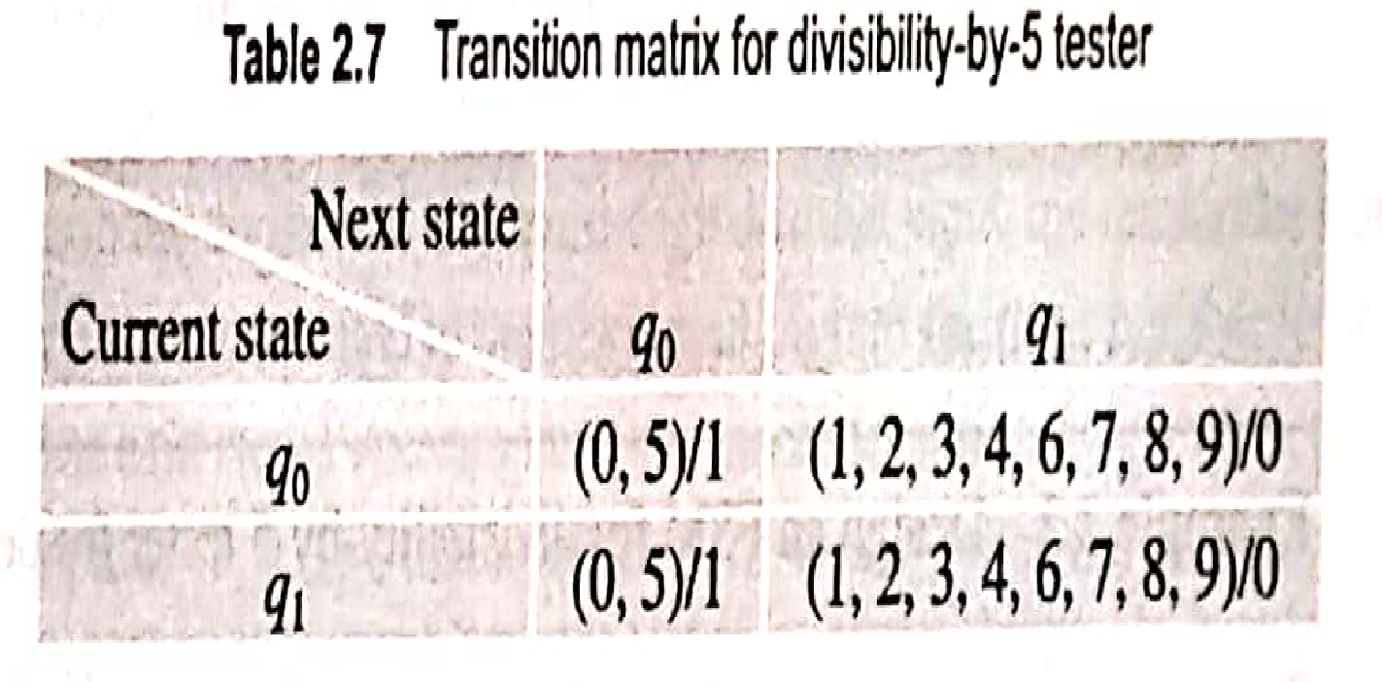
Example 3:

Slide 17
Example 3:
CS | I/p Symbol | NS | O/P Symbol
Simulation for input 101

Slide 18
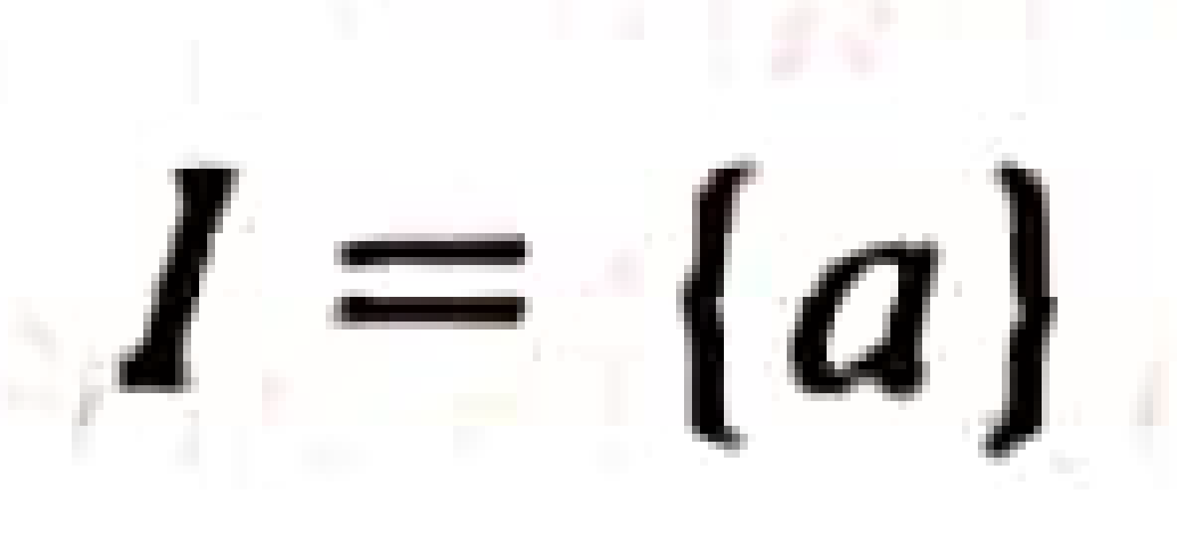
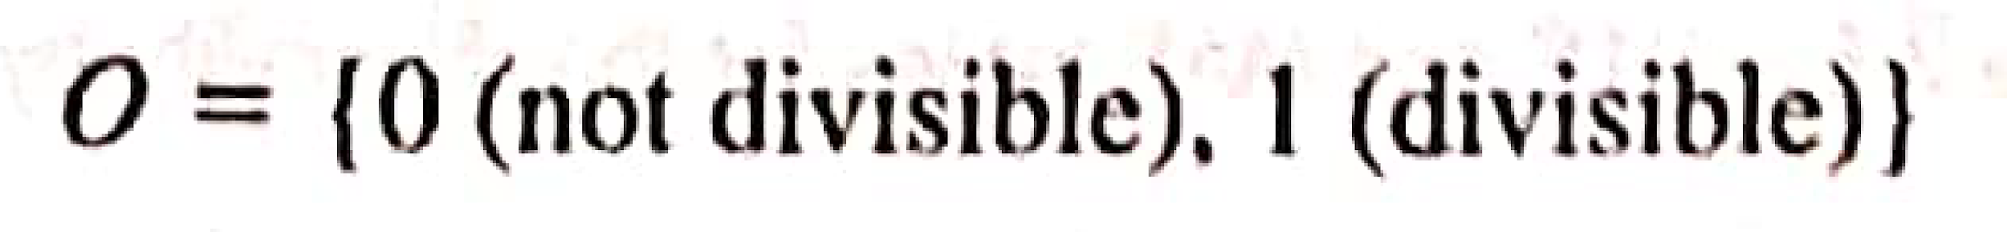
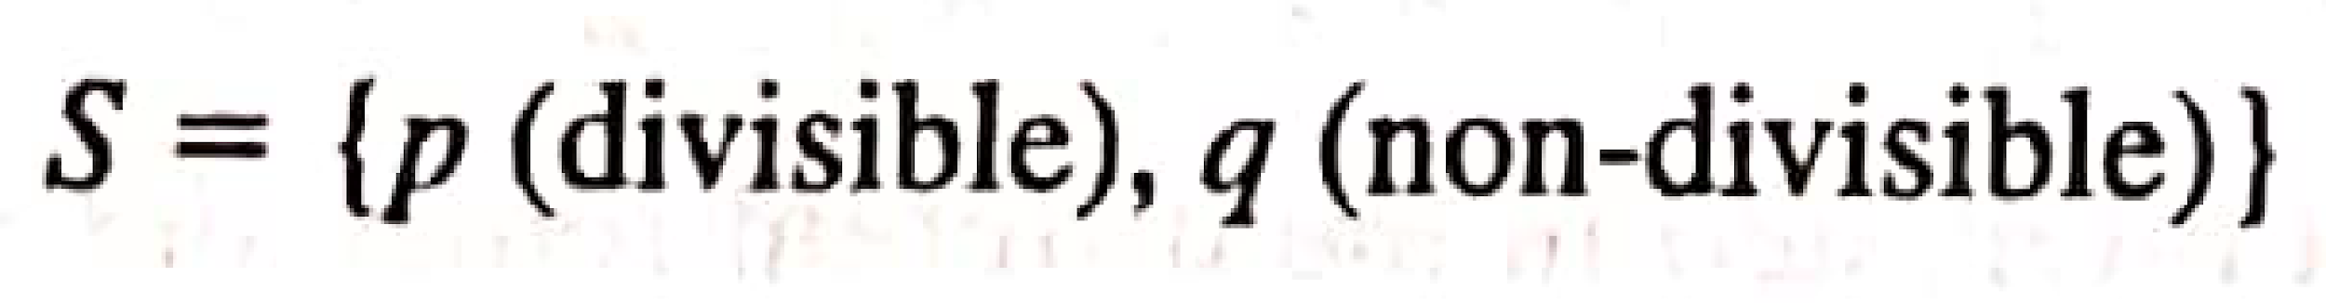
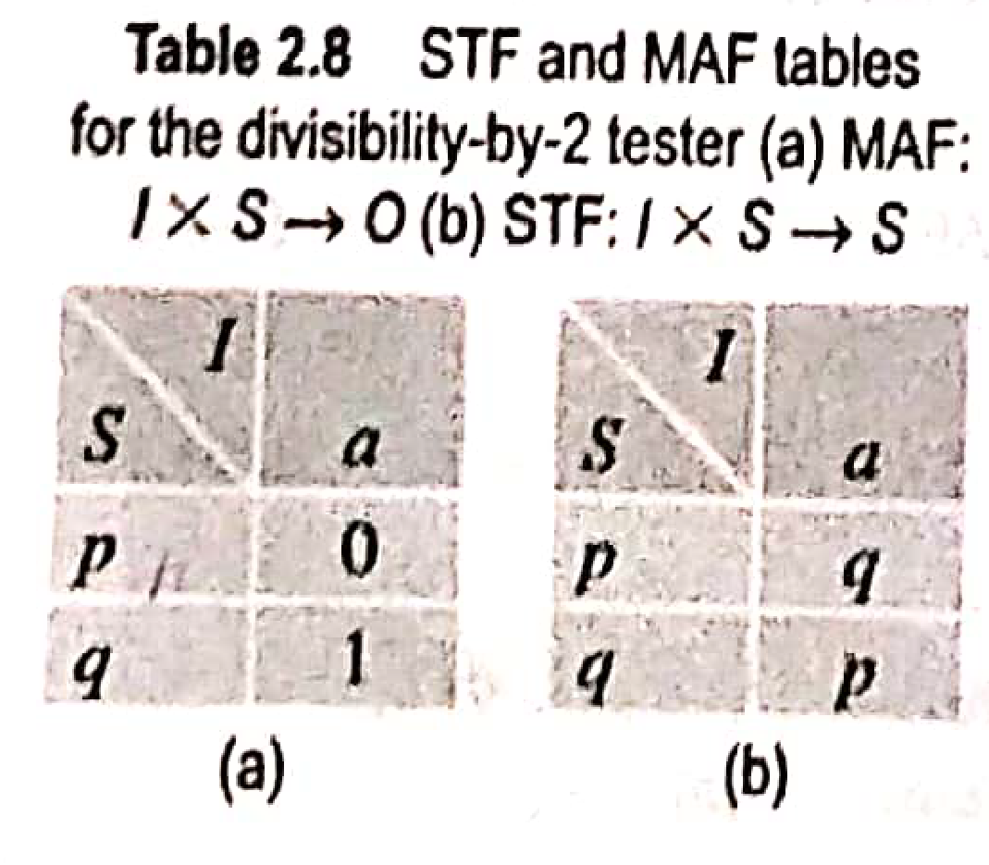
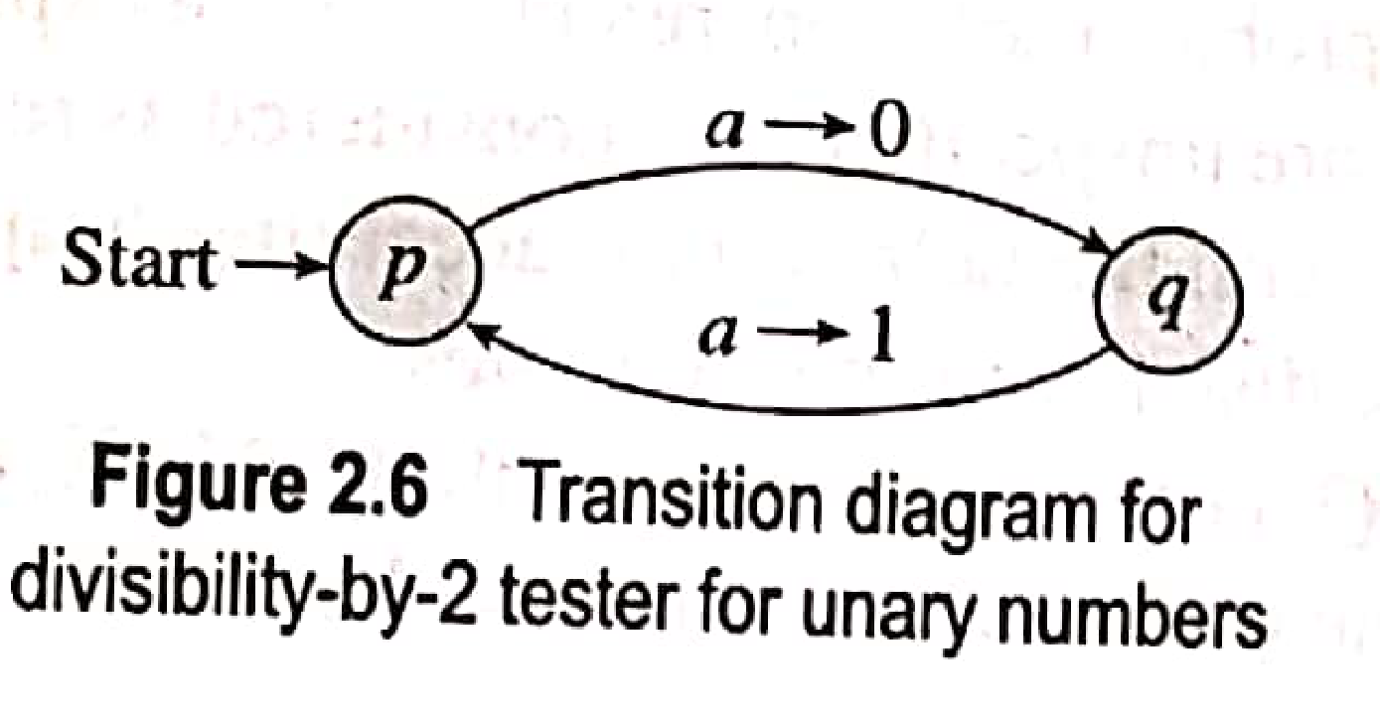
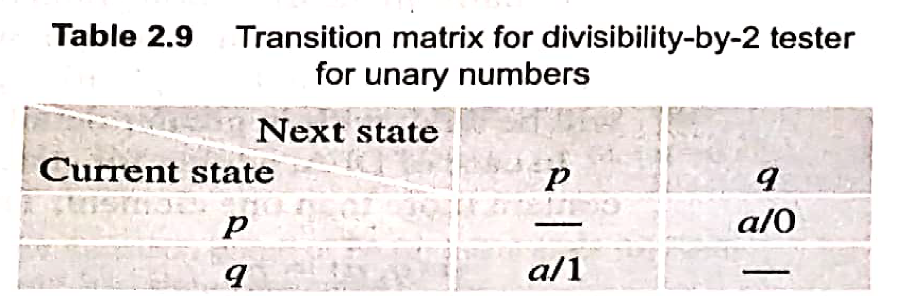
Example 4:

Slide 19
Finite Automaton (FA)
FA is a mathematical model of FSM.
Informally, a state diagram that comprehensively captures all possible states and transitions that a machine can take while responding to a stream or sequence of input symbols
FA portrays the FSM as language acceptor.
Recognizer for “Regular Languages”

Slide 20
FA– Formal Definition
FA is formally defined as a collection of 5 tuples:
FA= (Q, ∑ , δ q₀, F )
Where
Q is a finite set of states
∑ is a finite set of input symbols (alphabet)
q₀ is a start state
F is a finite set of accepting states
δ is a transition function, which is a mapping Q x ∑ 🡪 Q
No output Set O. Hence called as FA without Output.
Upon reading entire input string if machine resides in any of the final states, then i/p string is considered to be accepted by m/c otherwise rejected.
Thus FA acts as an input acceptor or rejector.

Slide 21
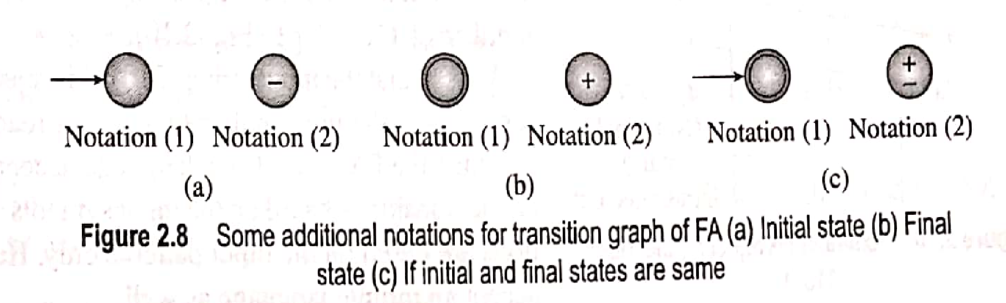
Transition Graph for Finite Automata
Almost same as FSM.
Only difference is thet in FA, we need to represent final states and we do not have output symbol.

Slide 22
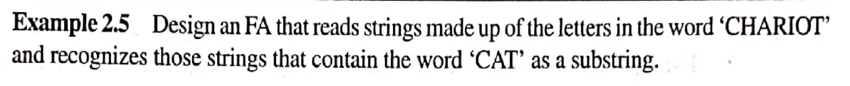
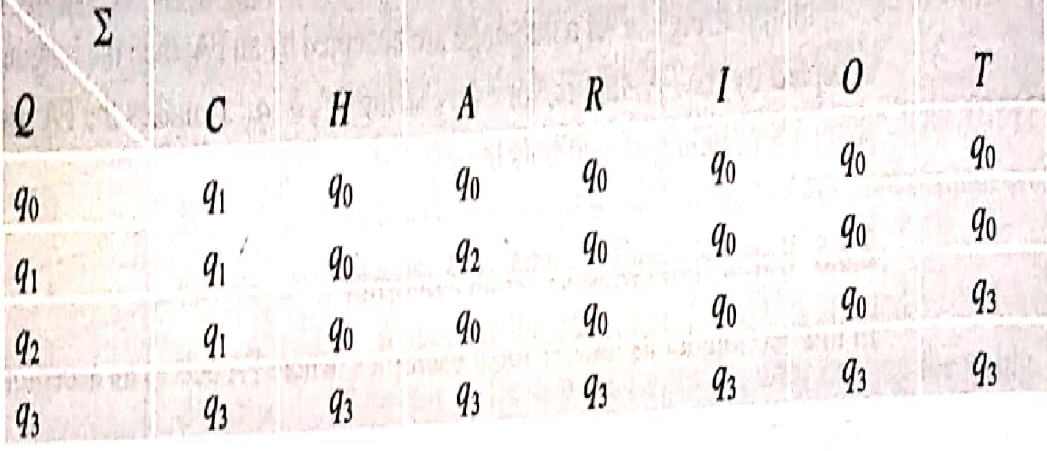
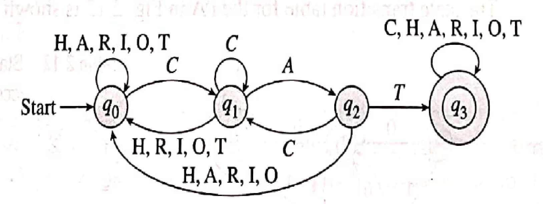
Examples of Finite Automata as Acceptor
The required FA is M = (Q, ∑ , δ , q₀, F )
∑ = { C,H,A,R.I,O,T}
Q={ q_{0,} q_{1,} q_{2,} q₃ }
q₀ = Initial State of machine
q₁ = State of the machine after reading a string ending in C
q₂ = State of the machine after reading a string ending in CA
q₃ = State of the machine after reading a string ending in CAT
F = { q₃ }
δ : Q x ∑ --> Q

Slide 23
Examples of Finite Automata as Acceptor
δ : Q x ∑ --> Q
F = { q₃ }
Simulation for input String “ACHCATRI”
CS | I/p Symbol | NS | O/P Symbol

Slide 24
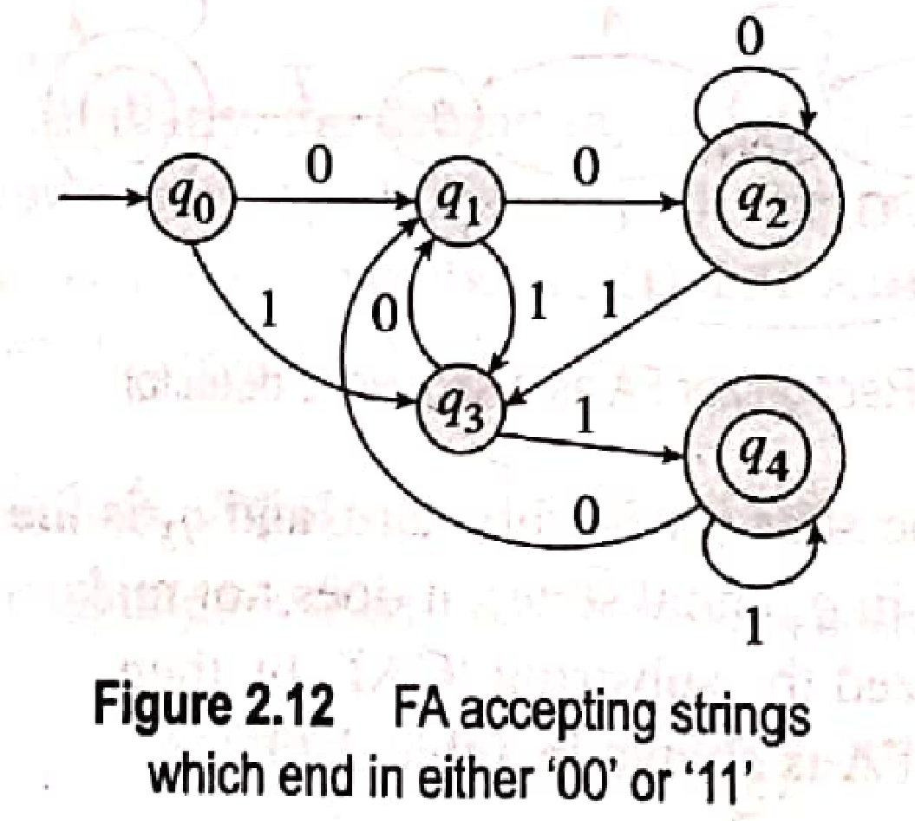
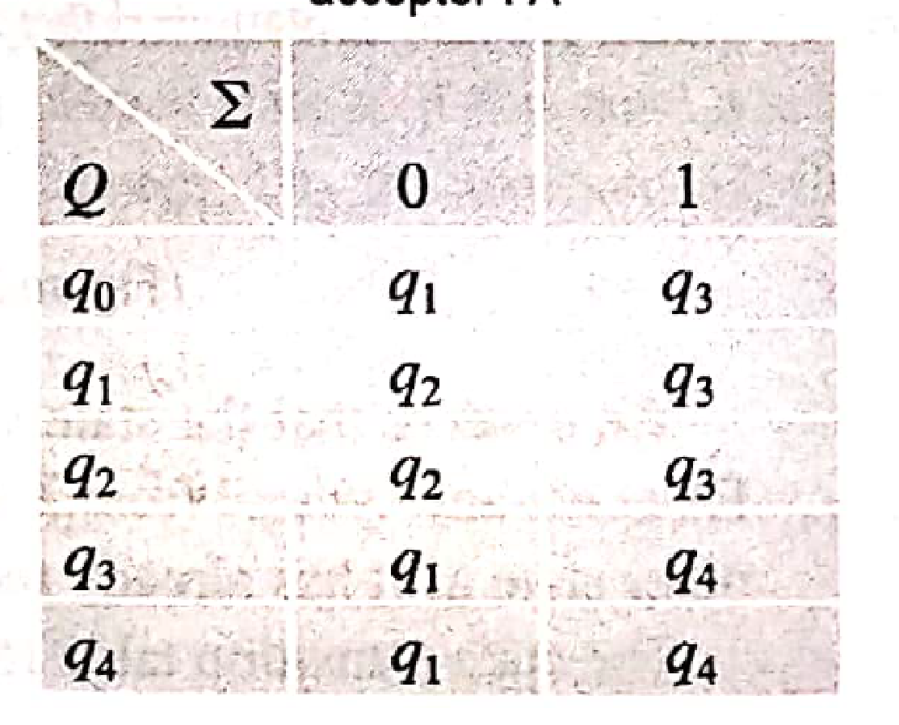
Examples of Finite Automata as Acceptor
Design a FA that accepts all strings over ∑={0,1} which end with either ‘00’ or ‘11’
The required FA is M = (Q, ∑ , δ , q₀, F )
∑ = {0,1}
Q={ q_{0,} q_{1,} q_{2,} q_{3,} q₄ }
q₀ = Initial State of machine
q₁ = State of the machine after reading a string ending in 0
q₂ = State of the machine after reading a string ending in 00
q₃ = State of the machine after reading a string ending in 1
q₄ = State of the machine after reading a string ending in 11
F = { q_{2,} q4 }
δ : Q x ∑ --> Q

Slide 25
Exercises
Design a FA for divisibility by 4 tester for a binary number.
Design a FA for divisibility by 3 tester for a ternary number.
Design FA that accepts all strings over ∑={x,y} ending with xyy.
Design FA that accepts all strings over ∑={x,y} beginning with xyy.
Design FA that accepts all strings over ∑={x,y} having xyy as a substring.
Design FA that accepts all strings over ∑={x,y} not having xyy as a substring.
Design FA that accepts all strings over ∑={x,y} having xyy or xxy or both as a substring.
Design FA that accepts all strings over ∑={x,y} having neither xyy nor xxy as a substring.

Slide 26
Exercises
Design a FA for divisibility by 4 tester for a binary number.

Slide 27
Exercises
Design a FA for divisibility by 3 tester for a ternary number.

Slide 28
Exercises
Design FA that accepts all strings over ∑={x,y} ending with xyy.

Slide 29
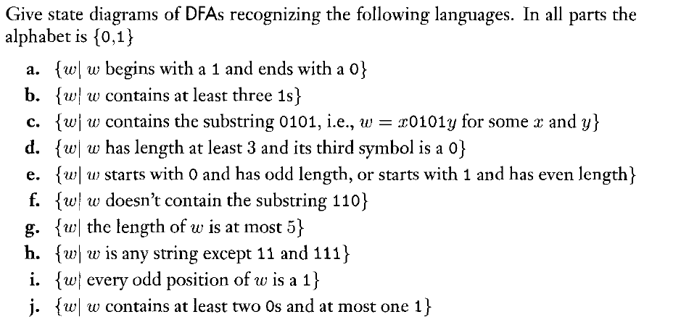
Exercises

Slide 30
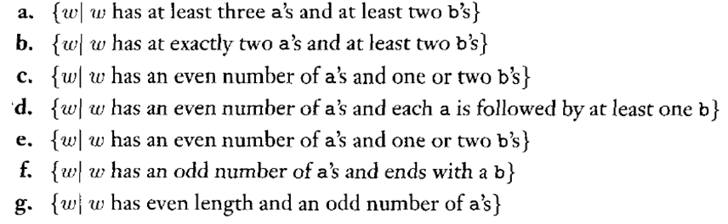
Exercises
Design DFA for the following languages:

Slide 31
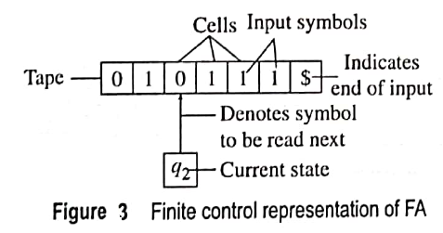
FA as finite Control
Input string is written on finite tape, one symbol per cell.
$ indicate end of input string.
Pointer or head points to cell on tape from which next input symbol can be read.
Head is labeled by the state label that represents the current state of the machine
FA reads symbols one by one from finite tape
After reading symbol head always moves to right to read the next symbol.
If it reads $, that means its end of input and at this stage, if the FA is in final state, string is Accepted else Rejected.

Slide 32
Types of FA
Finite Automata
FA without o/p
FA with o/p
NFA
DFA
Moore m/c
Mealy m/c

Slide 33
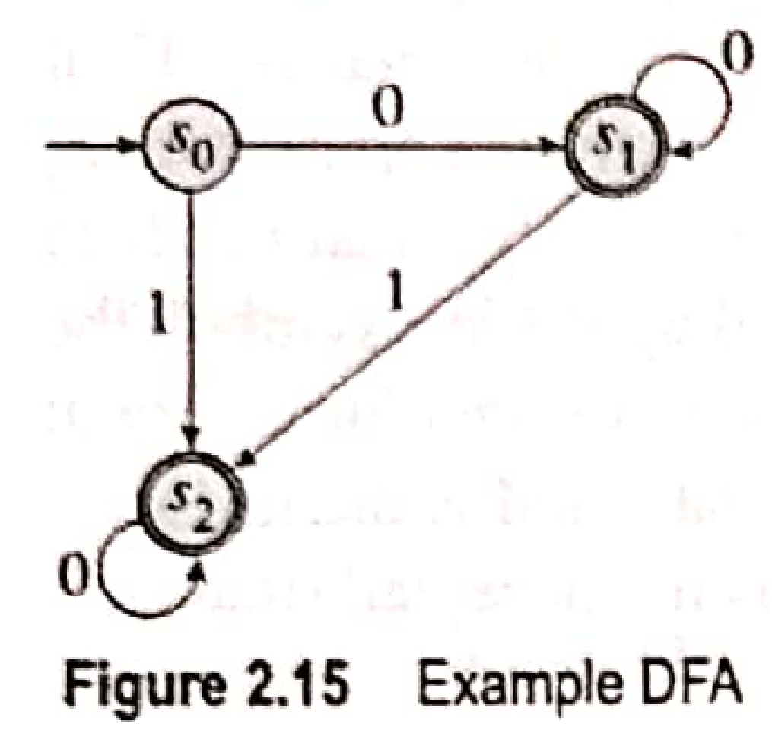
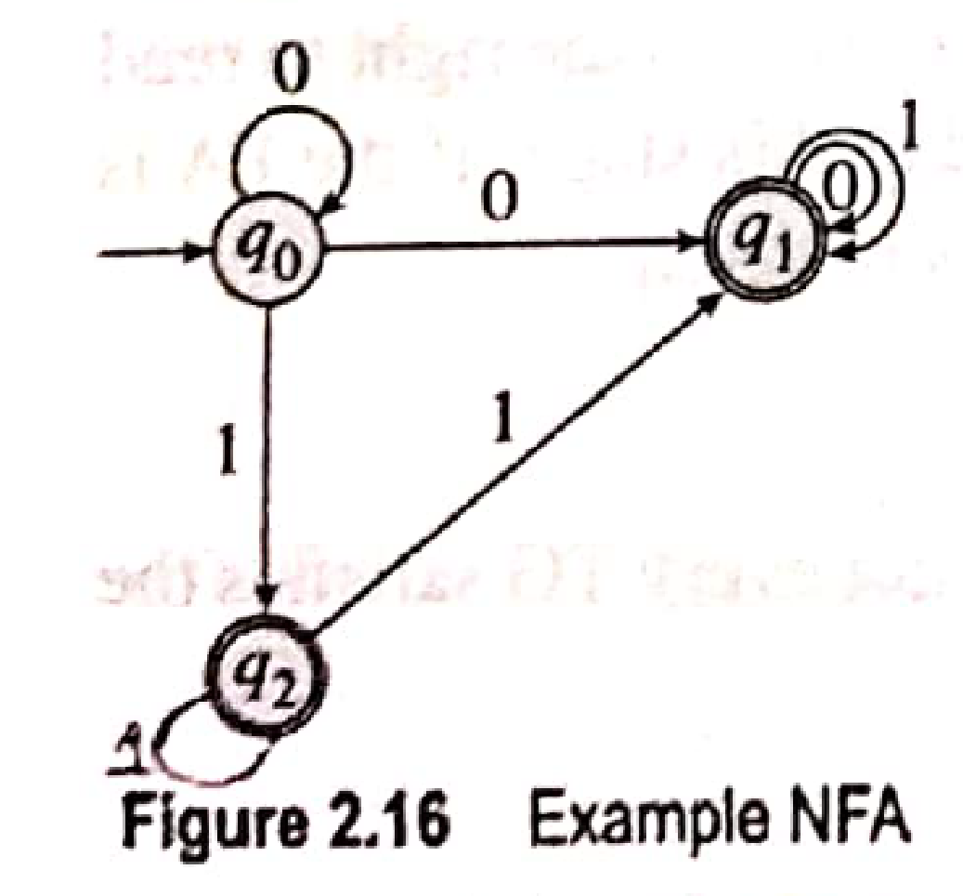
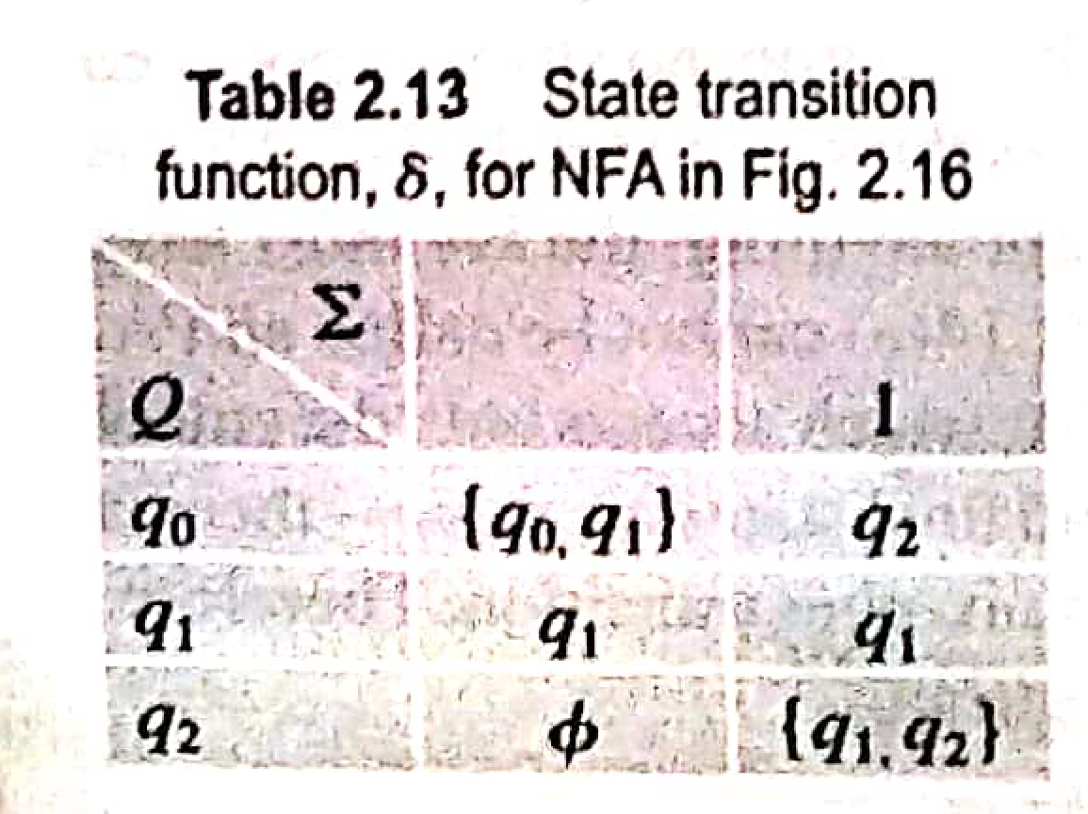
FA without Output
FA without o/p :
Deterministic Finite Automata (DFA)
A FA is said to be deterministic if for every state, there is a unique input symbol that takes the state to required next unique state.
There can not be more than one transitions on same input symbol from same state.
Non-deterministic Finite Automata (NFA)
A FA in which there exists at least one state from which there are more than one transitions on same input symbol.

Slide 34
Formal Definition
Deterministic Finite Automata (DFA)
DFA= (Q, ∑ , δ, q₀, F ) Where
Q is a finite set of states
∑ is a finite set of input symbols (alphabet)
q₀ is a start state
F is a finite set of accepting states
δ is a transition function, which is a mapping Q x ∑ 🡪 Q
Non Deterministic Finite Automata (NFA)
NFA= (Q, ∑ , δ ,q₀, F ) Where
Q is a finite set of states
∑ is a finite set of input symbols (alphabet)
q₀ is a start state
F is a finite set of accepting states
δ is a transition function, which is a mapping Q x ∑ 🡪 2^{Q} except Φ

Slide 35
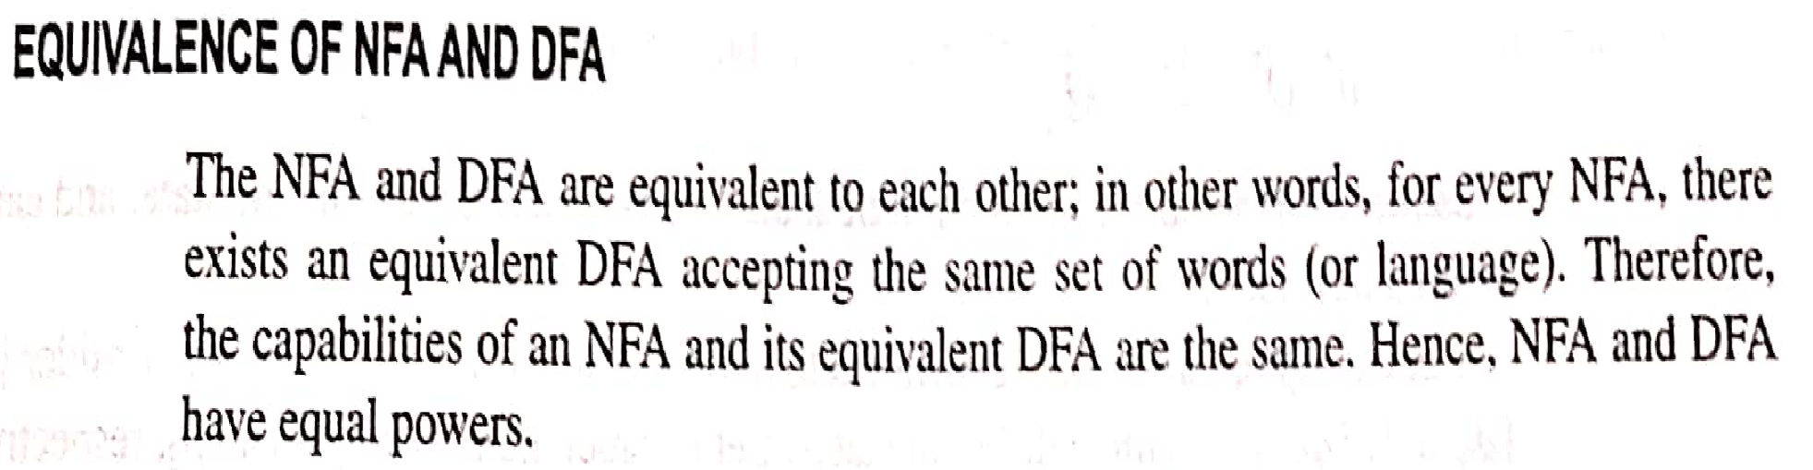
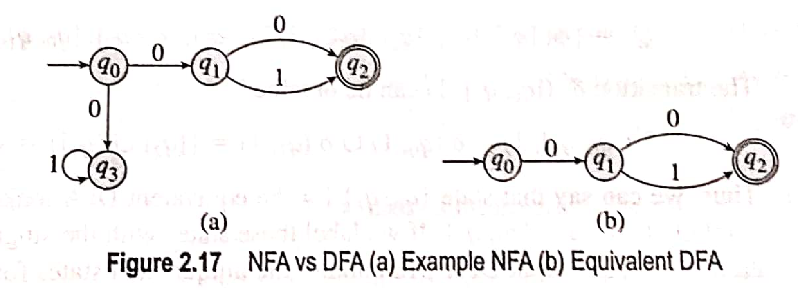

Slide 36
NFA To DFA Conversion (Method I)
The Given NFA M = (Q, ∑ , δ ,q₀, F ) can be converted to its equivalent DFA M’ = (Q’, ∑ , δ’ ,q₀, F’ ) where :
Q’ is a finite set of states= 2^{Q} except Φ
∑ is a finite set of input symbols (alphabet)
q₀ is a start state
F’ is a finite set of final states=A set of states from Q’ that contains at least one final state of M
δ' is a transition function, which is a mapping Q’ x ∑ 🡪 Q’

Slide 37


Example
o
1
O, 1
q 0
q 1

Slide 38




Solution

Slide 39


Solution
F’= set of all states in Q’ that contains at least one final state of given NFA
={ [ q1], [q0,q1] }

Slide 40



Solution

Slide 41


Solution

Slide 42
Equivalent states
Two or more states are said to be equivalent states if
They undergo the same transitions on reading the same input symbol , and are of the same type ie. Either final or non-final.
Ie. All these states move to the same next state.
The equivalent states are used to minimize DFA.
If there are more than one equivalent states we can remove all the equivalent states except one.

Slide 43

DFA Minimization Rules

Slide 44





Slide 45




DFA Minimization

Slide 46

Further Minimization of DFA
Replace
9 by 4
12 by 7

Slide 47

Further Minimization of DFA

Slide 48
Further Minimization of DFA
Unreachable States
A state is said to be an ‘unreachable state’ if it cannot be reached from the initial state on reading any input symbol. Hence must be removed.
E.g. states 2, 3, 4, 8 are unreachable states
Dead States
These are the states which has no outgoing transitions except to themselves. These are also called as trap states because once entered there is no escape.
These dead states must be removed in order to minimize the DFA.

Slide 49

Minimized DFA

Slide 50










Slide 52



Slide 53


Thus in Mealy machine, output depends on both the current state as well as current input symbol

Slide 54





Slide 55




Slide 56



δ : Q x ∑ 🡪 Q
λ : Q x ∑ 🡪 Δ

Slide 57






δ : Q x ∑ 🡪 Q
λ : Q x ∑ 🡪 Δ

Slide 59





Δ = {0,1 }

Slide 60




Slide 61




Slide 62


Mealy Machine:

Slide 63




Slide 64


Slide 65


Slide 66



Moore to Mealy machine conversion

Slide 67



Mealy to Moore machine conversion

Slide 68


Slide 69


Convert following Mealy machine to its equivalent Moore Machine

Slide 70



